Slide 1
Lecture 2: Basics
CS 352 – Dr. Lan Yang

Slide 2
Numbers
What do you expect Clisp to show you?
%clisp
>3
>1234567890
>3.1
>0.0000005
>2/3 ;Python?
>4/6
>1/0

Slide 3
Evaluation
5 -> 5
(1+ 5) -> 6 //note: 1+ is add1
(1- 5) -> 4 //here 1- is sub1
(+ 2 3) -> 5
(* 4 7) -> 28
Observation: prefix notation (Python: infix)
Note: + or 1+ called operator or function which could take arguments

Slide 4
Arguments
%clisp
>(1+ 2)
3
>(1+ 2 5)
*** - EVAL: too many arguments given to 1+: (1+ 2 5)
1.Break> abort
>(1+)
***-EVAL: too few arguments given to 1+” (1+)
1.Break> abort
Observation: some functions requires fixed number of arguments

Slide 5
Arguments -- continue
(+ 2 3) -> 5
(+ 2 3 2) -> 7
(+ 3) -> 3
(+) -> 0 note: identity element for addition
(*) -> 1 note: identity element for multiplication
Observation: some functions are flexible in argument list – some takes any number of arguments
--expressions in prefix notation have such flexibility

Slide 6
Evaluation of a list
When eval (the Lisp interpreter/evaluator) sees a list
It expects that the first element of the list must be the name of a defined function
Check if number of arguments correct?
Evaluate arguments recursively
Apply the function

Slide 7
Evaluation – improper form
>(2 3)
***-EVAL: 2 is not a function name
>(hello 3)
***-EVAL: undefined function HELLO

Slide 8
Evaluation
Normal functions evaluate their arguments first
Thus, we have nested function calls
(+ 3 5) -> 8
note: 3 evaluates to 3, 5 evaluates to 5, these values passed to operator + which returns 8
(1+ 3) -> 4
(1+ (+ 4 7)) -> 12 …what evaluated first?
(1+ (1+ 4)) -> 6
(1- (1+ 7)) -> 7
(+ (1+ 5) (+ 2 3) 4) -> 15
Python: operator precedence and associative rules

Slide 9
Python: Arithmetic Operators
+ - * / // % **
floor division //
rounds down to nearest whole number
classic division /
modulus (remainder) operator %
exponentiation operator **
Operator precedence
Highest **
unary + and –
* / // %
Lowest + -

Slide 10
Evaluation – getting into trouble
>(/ 1 0)
*** /: Divide by zero
The following restarts are available
ABORT:

Slide 11
quote – special operator
>(quote (+ 3 5))
(+ 3 5)
>’(+ 3 5)
(+ 3 5)
quote operator has a distinct evaluation rule:
do nothing
Why? – Lisp provides the quote as a way of protecting expressions from evaluation. (A good symbolic programming feature)
>(quote (quote (+3 5))) … What will be the output?

Slide 12
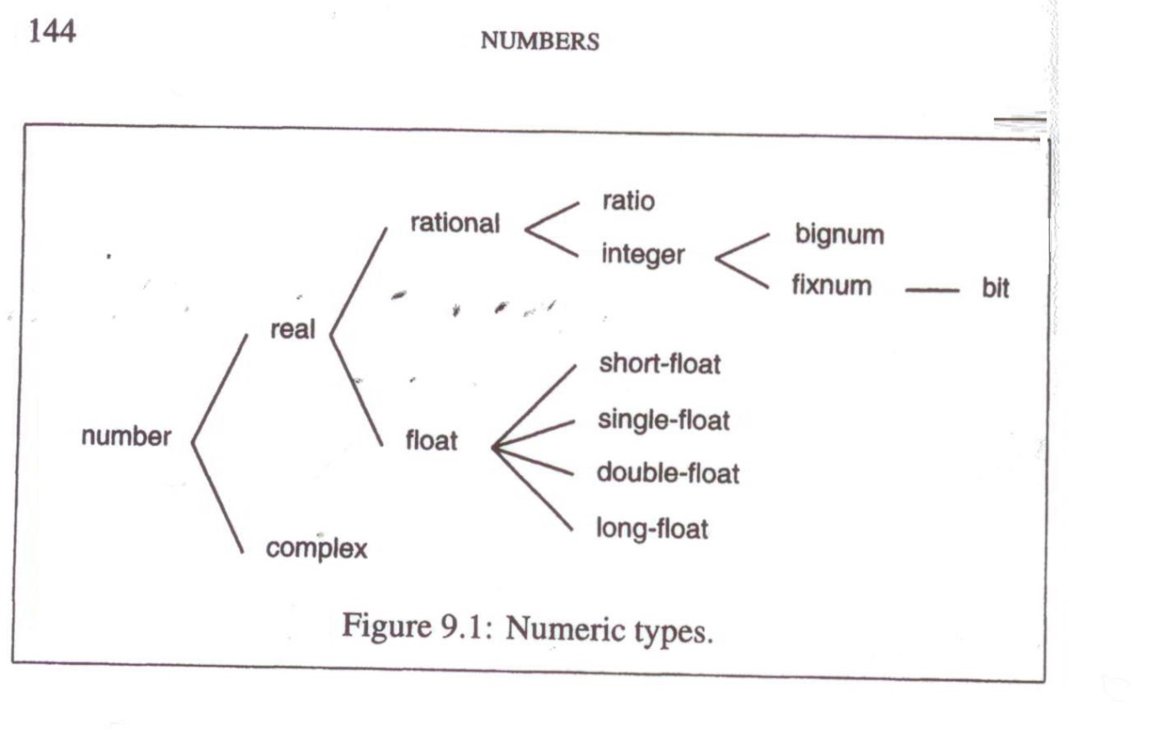
Numeric Types
Common Lisp offers a rich set of numeric types

Slide 13
Python: Numerical Data Types
Numeric types: int, long, float, complex
Boolean type: boolean
boolean values: True, False

Slide 14
Examples
Real
Rational
Integer
Ratio (ex. 3/5, 2/3)
>(+ 2/3 1/3) ;what will be output?
Float
Short-float, single-float, double-float,long-float
Denoted by s, f, d, l respectively
May follow by an integer as the power, e.g. L0
Complex
(a+bi) is written as #c(a b)
> (+ #c(1 -1) #c(2 1)) ;what will be output?

Slide 15
Strings
A string of characters enclosed in double quotes
Example: as file name (load “foo.lsp”)
Notes to load function:
the function load takes one argument, the name of the file to be loaded, represented as a string
Some implementation uses “.lisp” instead of “.lsp” as the extension for Lisp files
(load ‘foo.lsp) also supported -- why?
Question: Is (LOAD “foo.lsp”) same as (load “foo.lsp”) or not?
Lisp: case insensitive
Python: case sensitive

Slide 16
Symbols
Don’t commonly supported by other languages
>’noodles
NOODLES
Symbols do not (usually) evaluate to themselves, so when referring to a symbol, should always quote it.
(more to be discussed later)

Slide 17
A quick test
What will be the output of the following?
>’pi
>pi
>’e
>e
In Python: pi and e are defined in math module so you have to import.

Slide 18
Lists
Represented as zero or more elements enclosed in parentheses, e.g. (1 2 3) or (1 (‘a 3 “hi”) (3.4 5))
Elements can be of any type, including lists
Mixed types okay; nested lists okay
Have to quote the lists, otherwise, Lisp would take them for function calls
>’(my 3 “Sons”)
>’(the list (a b c) has 3 elements)
… what will be the output?
> (sum 3) ;function call! assume sum function loaded
Empty list
Symbol nil or () as supported by common Lisp
Try: >()
>nil
Python: empty list []

Slide 19
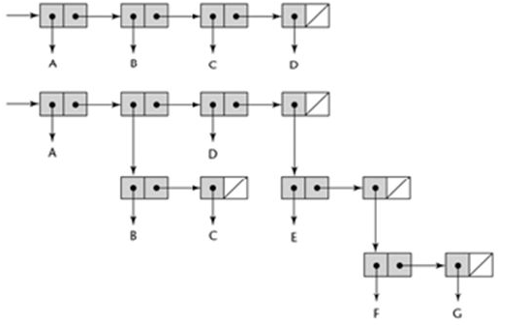
Lists representation

Slide 20
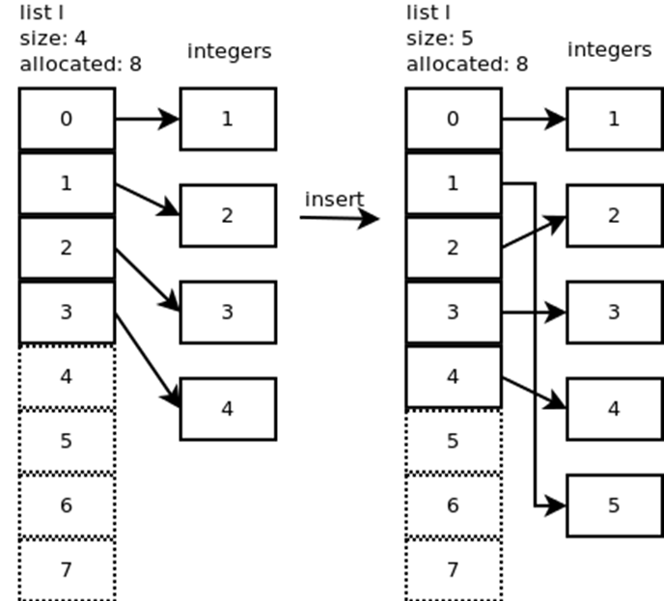
Python lists
Examples
[1, 2, 3]
[1, [‘a, 3, “hi”], [3.4, 5]]
Representation
array and linked list mixed
Python lists are sequences
storage allocation similar to
Java’s array lists

Slide 21
Function list
May build lists by calling list
Its arguments will be evaluated within the call
Example
>(list ‘my (+ 2 1) “Sons”)
… what will be output?
… what will happen to >(list my ‘(+ 2 1) “Sons”)
>(list ‘(+ 2 1) (+ 2 1))
… what will be output?
Python: factory function list

Slide 22
List operations (1)
Function cons
Builds lists
If second argument is a list, it returns a new list with the first argument added to the front
>(cons ‘a ‘(b c d))
>(A B C D)
>(cons ‘a (cons ‘b nil))
>(A B)
Compare with
>(list ‘a ‘b)
>(A B)

Slide 23
List Operations (2)
car and cdr
Primitive functions for extracting the elements of lists
car: first element of the list
cdr: everything after the first element
>(car ‘(a b c))
>A
>(cdr ‘(a b c))
>(B C) …note: the result is a list
>(car (cdr (cdr ‘(a b c d))) ;what is the result?
Also, compare with >(third ‘(a b c d))
>(nth 3 ‘(a b c d))
Python:
lst = [‘a’, ‘b’, ‘c’, ‘d’]
lst[3]

Slide 24
Symbols
In Lisp, you could have symbols (such as used in math)
>(car ‘(a b c))
>A ;A is a symbol
>(cdr ‘(a b c))
>(B C) ;(B C) is a list of symbols
>(third ‘(a b c d))
>(nth 3 ‘(a b c d))
Symbols are a feature of symbol programming, unfortunately not implemented in Python.

Slide 25
Finding meanings of operations
>(describe ‘car)
>(apropos ‘car)
Check: what information the Lisp evaluator/interpreter will provide you?

Slide 26
Truth/False
Symbol t and nil
t: true
nil: false
t and nil evaluated to themselves
Lisp’s logic
false <-> nil; true <-> anything else except nil
similar to C language
Examples
>(listp 27)
NIL
>(listp ‘(a b c))
T
>(null nil)
T
>(not nil)
T
Python: bool type (True/False)
But may also use any type, e.g. not 3
[3, 5] and 3.4

Slide 27
Length of lists
What will be the output?
>(length nil)
>(length ‘(a))
>(length ‘a)
>(length ‘(a b c))
>(length ‘(a (b c) d))
>(length (cons ‘a ‘(b (c d))))
>(length (cons ‘(a f) ‘(b (c d))))
Note: (length (cons a L)) equivalent to (1+ (length L))
Prove: ?
Python: len

Slide 28
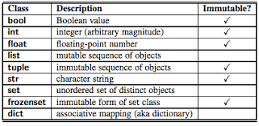
Compare: Python data types

Slide 29
Guided self-study
Lists: Python vs Lisp
List creation
Python: how many ways to create a list
Lisp: how many ways to create a list
Element access
How to access ith element in a list?
Python?
Lisp?
Iterating through elements
E.g. create a new list by doubling each element of an existing element
Code in Python
Code in Lisp

Slide 30
Summary
Lisp objects
Can represent both program and data
Format: atoms and lists

Slide 31
Code appreciation
While we will discuss these operators or functions in details in the future, here just a few illustrations to appreciate Lisp program
>(if (listp ‘(a b c))
(+ 1 2)
(+ 4 5))
>(if (listp 27)
(+ 1 2)
(+ 4 5))
>(if 27 1 2)
>(and t (+ 1 2))
… could you figure out the output and explain why?

Slide 32
Practice Exercises (1)
Describe what happens when the following expressions are evaluated:
(+ (- 5 1) (+ 3 7))
(list 1 (+ 2 3))
(if (listp 1) (+ 1 2) (+ 3 4))
(list (and (listp 3) t) (+ 1 2))
(car (cdr (cons (car ‘(a b)) cdr ‘(f g h))))
Using car and cdr to return the fourth element of a list
Give three distinct cons expressions that return (a b c)

Slide 33
Practice Exercises (2)
What could occur in place of the x in each of the following?
>(car (x (cdr ‘(a (b c) d))))
> B
2. >(x 13 (/ 1 0))
> 13

Slide 34
Today’s Assignment
Programming Assignment #1 (PA1)

